Slide 1

Principles of Program Design: Problem Solving with JavaScript
Chapter 8
Modules and Functions

Slide 2
Objectives
In this chapter, you learn to:
Explain the purpose of modular programming and functions
Describe how modular programming works with a top-down design methodology
Define global and local variables and their implications for writing functions
Create flowcharts for calling and defining modules

Slide 3
Objectives (cont’d.)
Use modules with and without arguments and modules that do and do not return values
Define passing arguments by value and passing arguments by reference
Define and contrast syntax errors and logic errors
Explain module cohesion and coupling

Slide 4
Introduction
Structured programming
  Method to achieve clarity
Module
  Section of code that performs a specific task
  What the module does:
    Should be apparent from its name and comments

Slide 5
Modular Programming and Top-Down Design
Top-down design steps
  Create a program’s overall outline
  Describe tasks to be accomplished
  Define the details later
Program’s main module
  All program code between keywords Start and Stop
  Can call additional modules

Slide 6
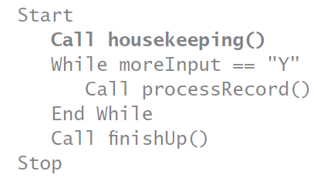
Modular Programming and Top-Down Design (cont’d.)
Example:
Main module calls the following modules:
  housekeeping(), processRecord(), and finishUp()

Slide 7
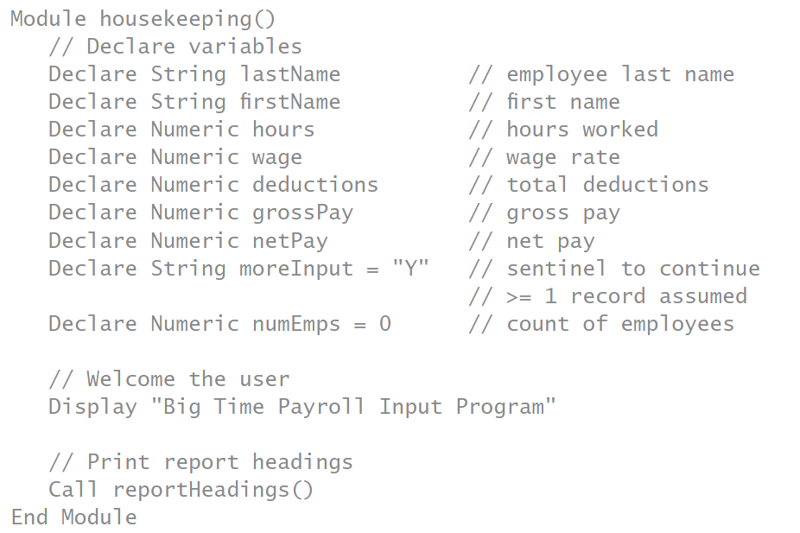
Modular Programming and Top-Down Design (cont’d.)
Modules can call other modules

Slide 8
Modular Programming and Top-Down Design (cont’d.)
Example program:
  Asks user to enter customer’s name and address
  Prints customer mailing labels
Instead of putting all code in main module
  Create a separate module: makeLabels()
Rules for naming modules
  Names start with lowercase letter
  Can contain letters, digits, hyphens, and underscores
  Cannot contain spaces

Slide 9
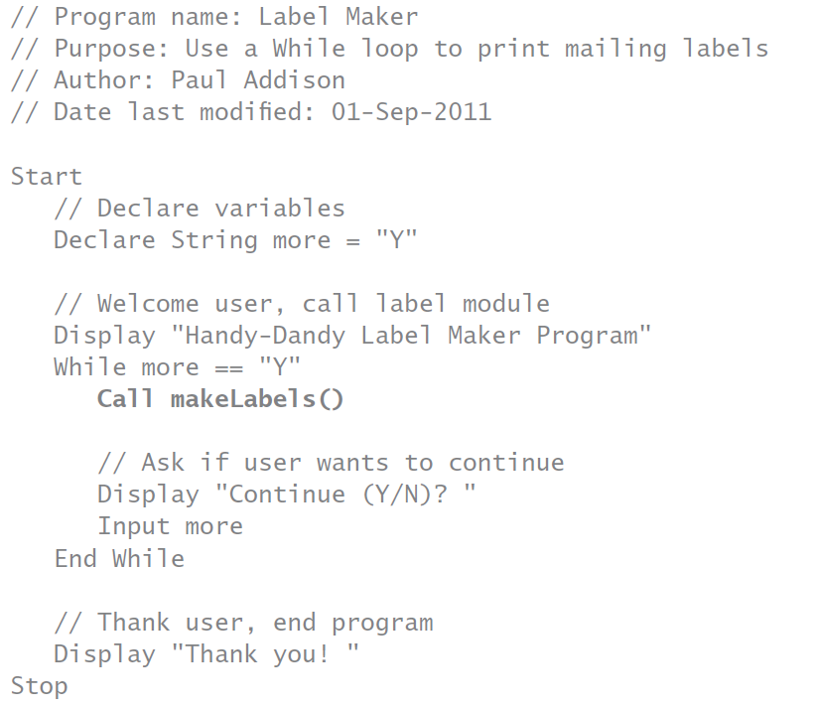

Slide 10
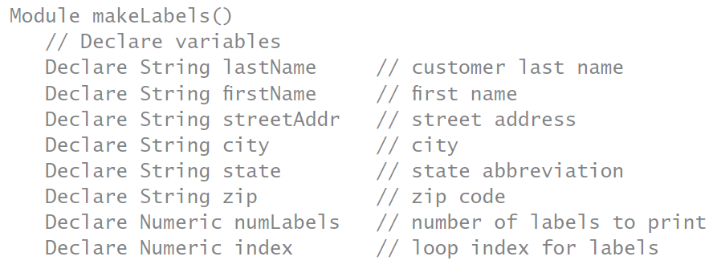
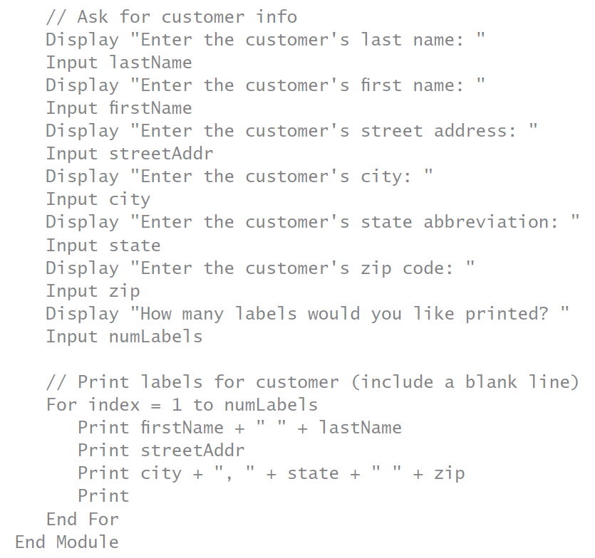

Slide 11
Modular Programming and Top-Down Design (cont’d.)
Global and local variables and scope
  Variables declared in a module
    Local to that module
    Available only while module is being performed
  Scope of a variable
    Section of program code in which variable can be accessed
Global variables
  Available to all modules in the program
  Declared explicitly as global
    Or declared in main module

Slide 12
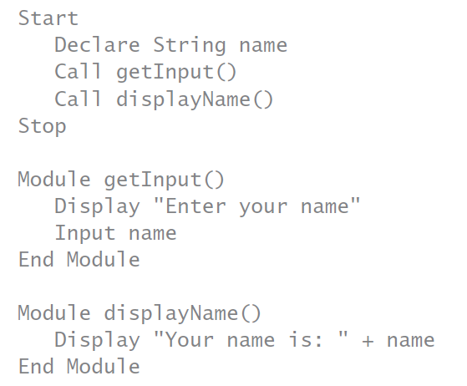
Modular Programming and Top-Down Design (cont’d.)
Example:
  name is a global variable

Slide 13
Modular Programming and Top-Down Design (cont’d.)
Advantages of local variables
  Programmers can work on different modules:
    Without worrying about variable name duplication
Local variables with the same name in two different modules
  Stored in two different memory locations
  Statements affecting one do not affect the other
Local variable with same name as a global variable
  Variable declared locally is used

Slide 14
Flowcharting Modules
Module flowchart shape
  Rectangle with stripes
  Indicates a predefined process
  Text inside rectangle:
    Contains name of module being called
Groups of similar activities:
  May be summarized in single flowchart shapes
  Example: declaring variables
    Specific variables listed to the right of the shape

Slide 15
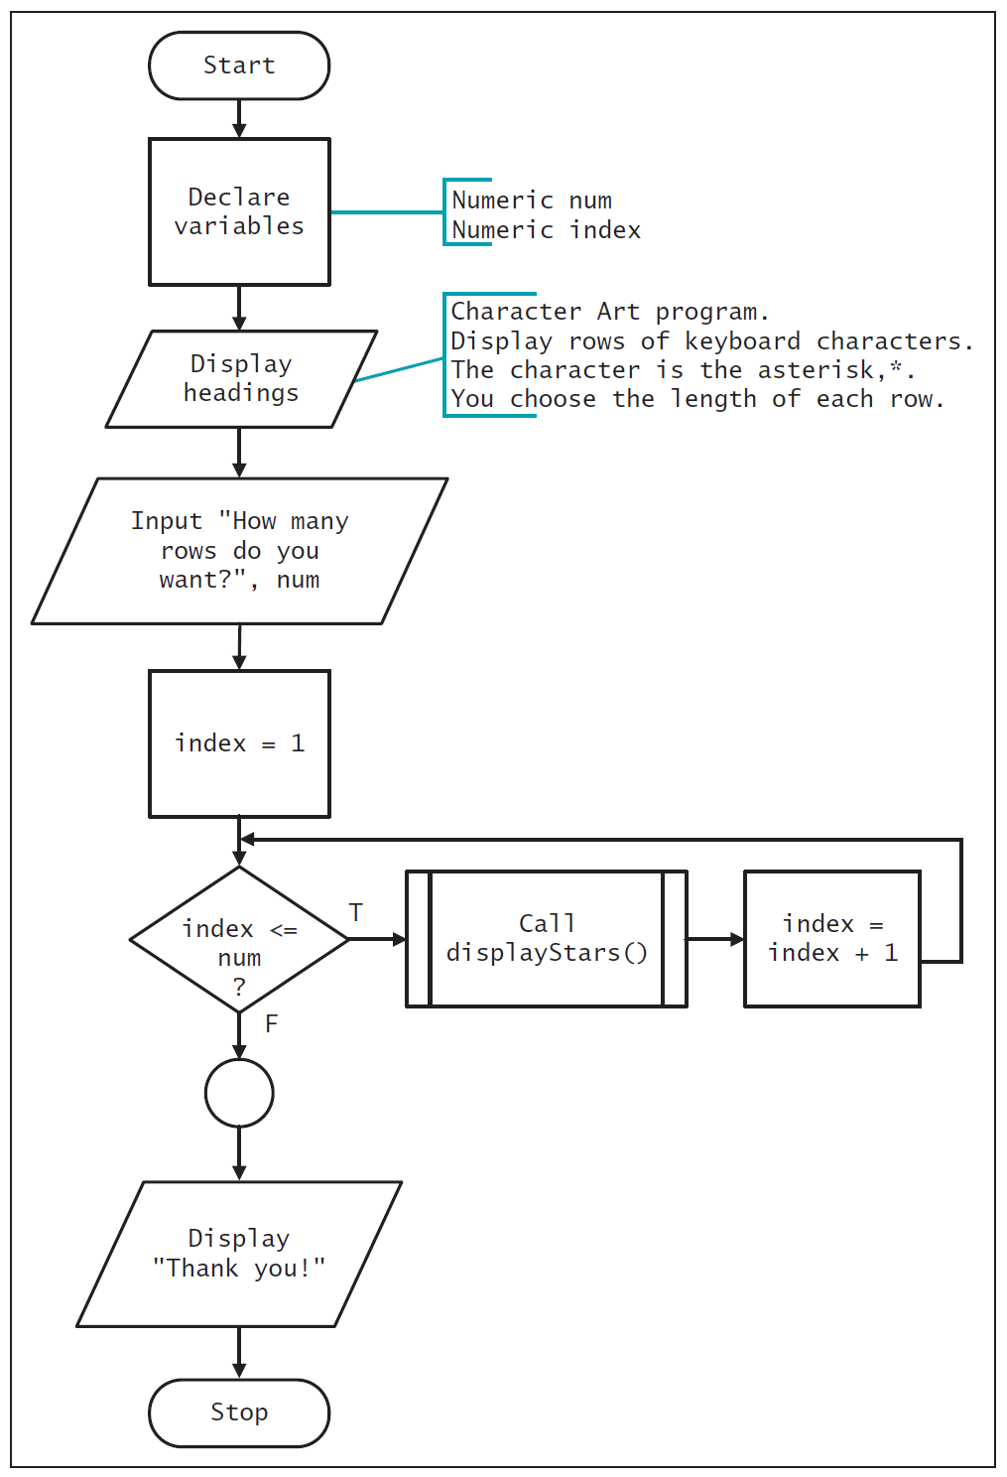
Figure 8-1 Flowchart for the Character Art main module

Slide 16
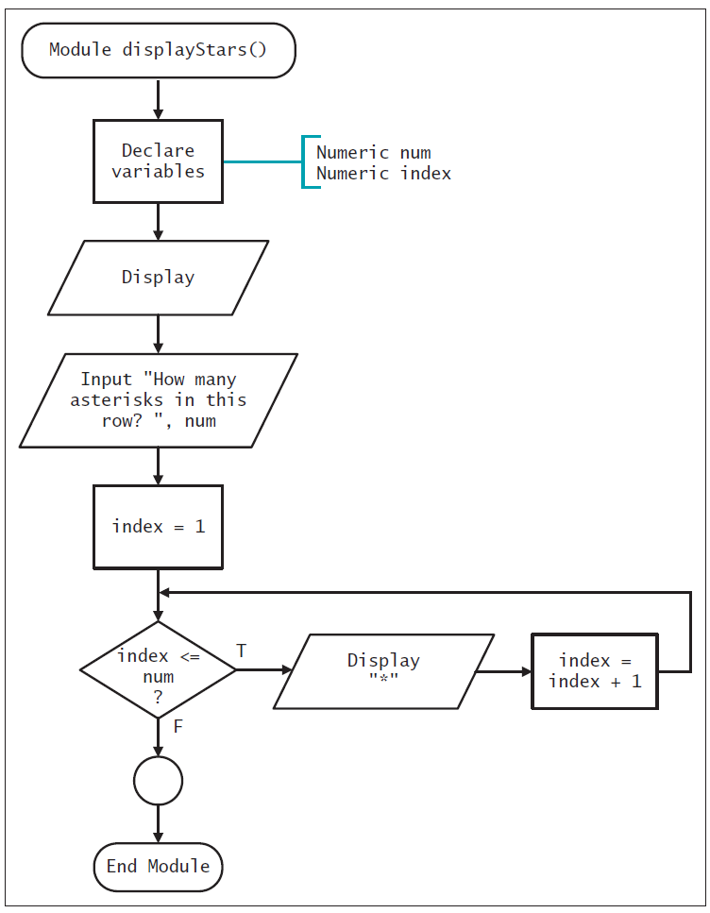
Figure 8-2 Flowchart for the displayStars() module of the Character Art program

Slide 17
Modules in JavaScript
Term “function” in JavaScript
  Used for all modules:
    Whether they return a value or not
JavaScript function placement
  Modules appear first as functions in <head> section
  Called from the <body> section
Function body enclosed in braces
<head> and <body> sections of HTML file:
  Have own <script> functions

Slide 18
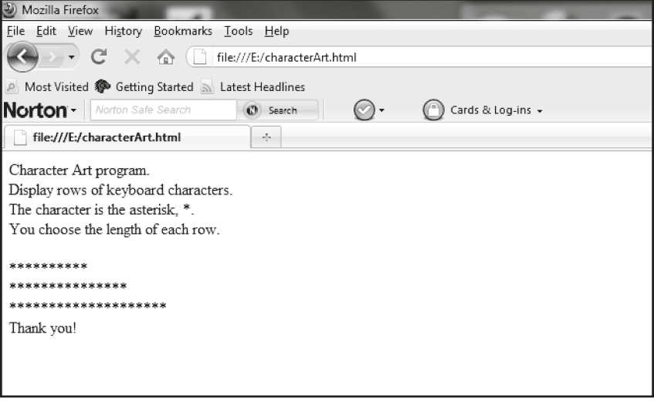
Modules in JavaScript (cont’d.)
Use function name to call a function
  Keyword Call is not needed
Complete Program 8-1 on pages 299-301
Figure 8-3 The characterArt.html program in a Web browser

Slide 19
Modules in JavaScript (cont’d.)
Modules that require arguments
  Module can use global variables
    Disadvantages: increases processing time and requires knowledge of all program variables
  Alternative
    Pass data as an argument to the module
Arguments
  Values represented as constants or variables
  Enclosed in parentheses following module name

Slide 20

Modules in JavaScript (cont’d.)
Example:
Module must declare argument’s data type
  And assign local variable name
Parameter
  Data type and variable pair

Slide 21
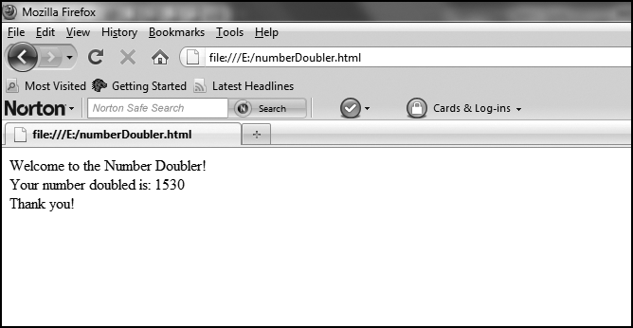
Modules in JavaScript (cont’d.)
Complete Program 8-2 on pages 303-304
Figure 8-4 The numberDoubler.html program in a Web browser

Slide 22
Modules in JavaScript (cont’d.)
Passing by value
  Local variable is initialized to argument’s value
Passing by reference
  Variable’s memory address is sent to module
  Less commonly used than passing by value
Passing multiple arguments
  Modules may accept more than one argument
  Parameters must match arguments sent:
    In number, data types, and order

Slide 23
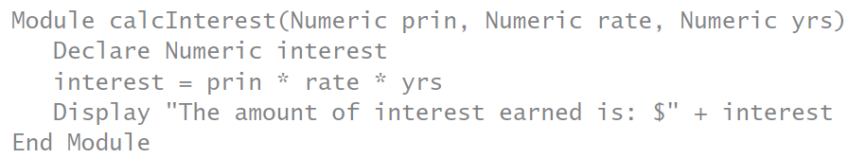
Modules in JavaScript (cont’d.)
Arguments may be different data types
Limit number of arguments to five or six
  If more, break up module into two
Example: passing multiple arguments

Slide 24
Modules in JavaScript (cont’d.)
Syntax error
  Occurs when a language’s rules are violated
Logic error
  Wrong instruction given to computer
    Not correct for solving the problem
Functions: modules that return values
  If data is needed by the calling module:
    Module can send return value back
  Functions can return only one value

Slide 25
Modules in JavaScript (cont’d.)
Functions
  Must be declared as a particular data type
    Data type is that of the returned value
  Written like a module:
    Except keyword Function is used in pseudocode
  Data type, function name, and parentheses
  Return statement at end
  Called by assignment statement
    Assigns returned value to variable left of equals sign
    Keyword Call not needed

Slide 26
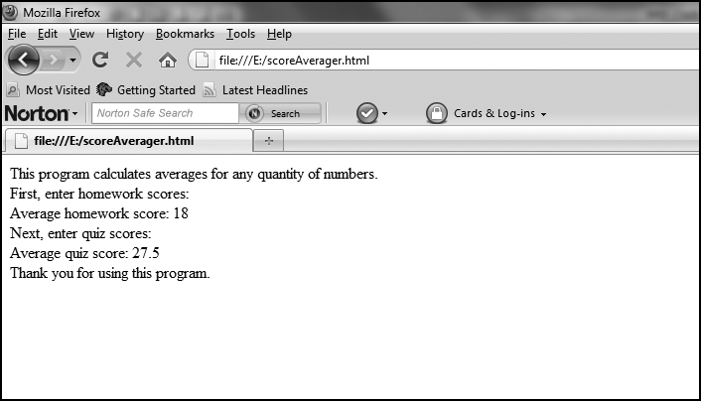
Modules in JavaScript (cont’d.)
Complete Program 8-3 on pages 308-309
  Then convert to JavaScript
Figure 8-5 The scoreAverager.html program in a Web browser

Slide 27
Module Efficiency: Cohesion and Coupling
Cohesion
  How much of module relates to single purpose
  Higher cohesion is better
    Can be used later for its single purpose
Coupling
  How much a module depends on other modules
  If function uses global variables:
    Highly coupled with main module
  Lower coupling is better

Slide 28
Module Efficiency: Cohesion and Coupling (cont’d.)
Don’t overmodularize
  Every task doesn’t need a module
Rule of thumb for creating a module
  Five to six statements related to same purpose
  Potential of being reused in additional places
Modularization advantages
  Main module easier to understand
  Can divide work among programmers
  Modules can be reused in a program

Slide 29
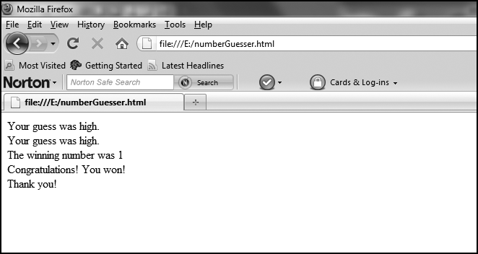
Module Efficiency: Cohesion and Coupling (cont’d.)
Complete Programmer’s Workshop on pages 313-316
  Then convert to JavaScript
Figure 8-6 The numberGuesser.html program in a Web browser

Slide 30
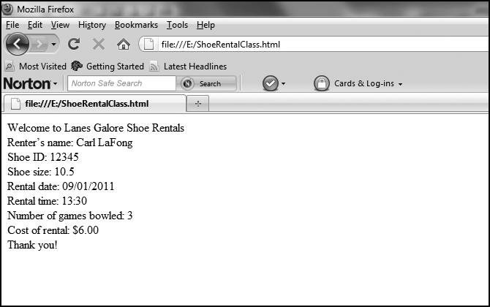
Module Efficiency: Cohesion and Coupling (cont’d.)
Complete Object Lesson on pages 316-319
  Then convert to JavaScript
Figure 8-8 The ShoeRentalClass.html program in a Web browser

Slide 31
Summary
Modules
  Sections of code that perform single tasks
  Make program’s purpose clearer
  Can be reused
  Flowchart representation: rectangle with stripes
Local and global variables
  Local variables declared in a module don’t conflict with variables in other modules
  Global variables can be used in all modules

Slide 32
Summary (cont’d.)
Arguments: data sent to modules
Functions: modules that return values
Modules called functions in JavaScript
  Whether they return value or not
Cohesion
  Degree to which statements and variables in a module relate to single purpose
Coupling
  Degree to which a module depends on other modules

